Slide 1
Coupon Purchase Prediction by Nicolas Girod, Shu Yun, Pokman Cheung, and Sara Zeid
https://www.kaggle.com/c/coupon-purchase-prediction

Slide 2
Main Issues
Deciding on model to use for recommendation system:
After research, stuck with content-based filtering method using cosine-similarity measure.
Calculated similarity value between each customer’s previous purchases and future coupons and used that to develop a personalized ranked list of future coupons for recommendation to each customer.
Deciding which variables to include in the model

Slide 3
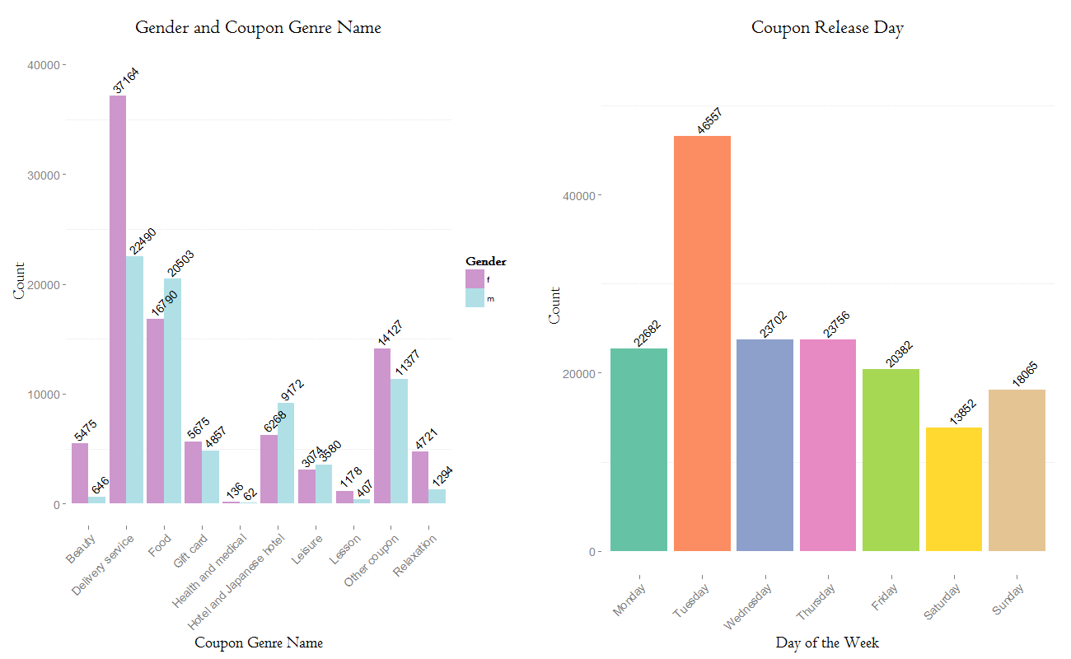
Exploration of Data

Slide 4
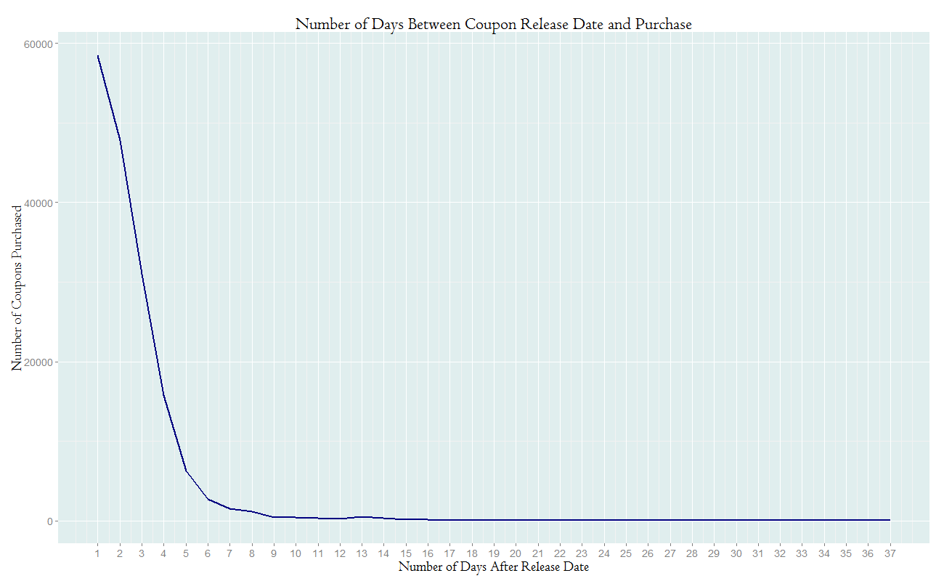
Exploration Cont’d

Slide 5
Looking at the Data
Many variables split up into different tables/files
Included all variables describing the coupons and the number of times a customer purchased each coupon.
Decided to exclude listing area, view count, and variables describing the user (age, gender, etc.)
Listing area: where each coupon was listed. Most were listed in more than 1 area.
View count: Didn’t seem to influence purchase.

Slide 6
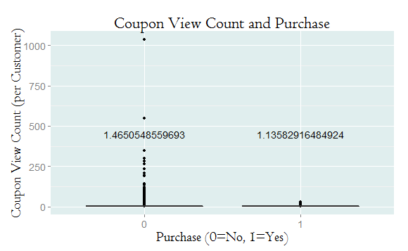

Slide 7
Code Optimization
After deciding on the method and variables, we needed a way to decide which variables should be given more weight in the similarity measure.
On kaggle evaluated according to Mean Average Precision (MAP). So:
Wrote a loop to run different weights in our model.
Wrote MAP function for testing the model with different weights and tested it on partitioned training set.

Slide 8
Code Optimization Cont’d
Improved recommendations:
Number of times each customer purchased a certain coupon
Log of certain variables
No difference or worse score:
Different groupings of coupon genres
Different similarity measure: Pearson correlation
Validity period

Slide 9
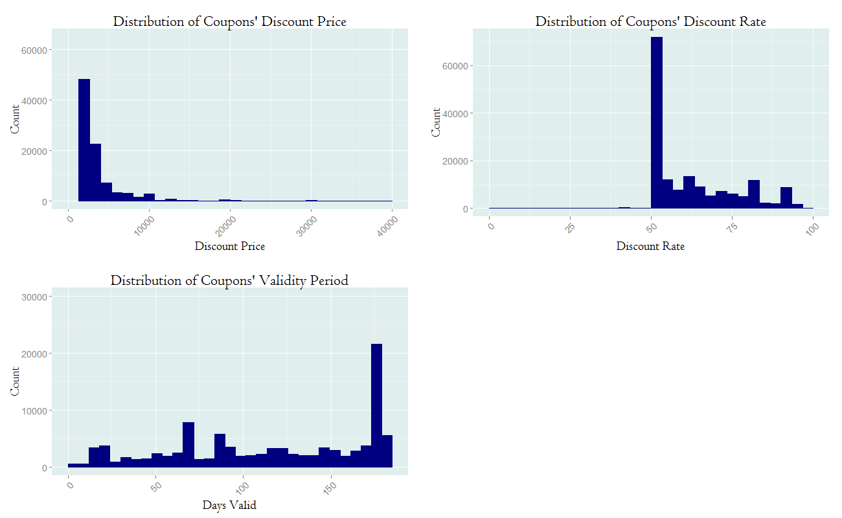
Log Transformed Variables

